Slide 1

Texture
Computer Vision and Pattern Recognition
CS 4243
S1-Y2023/24

Slide 2
Categories
Textures could be categorised according to their strength or cohesion feature:
A constant texture, is constant, slowly changing or approximately periodic. In a strong texture, the primitive set is well defined and the structure is rather regular. In other words, elements and spatial relations between them are clearly determinable.
In a weak texture definition of a crisp set of primitives is relatively more difficult and spatial correlation between primitives is also low.
An extremely weak texture could be considered as a random texture

Slide 3
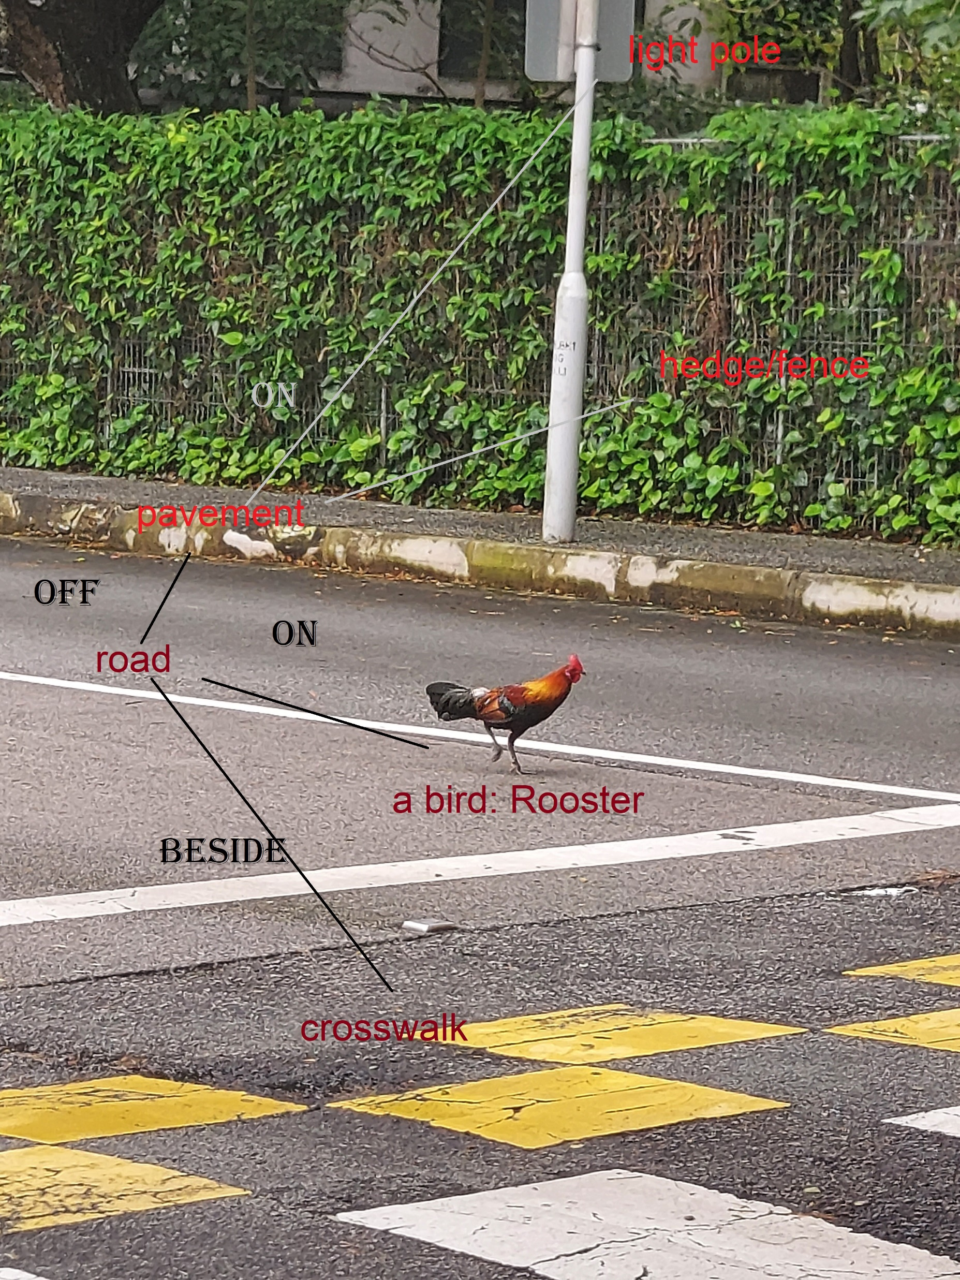
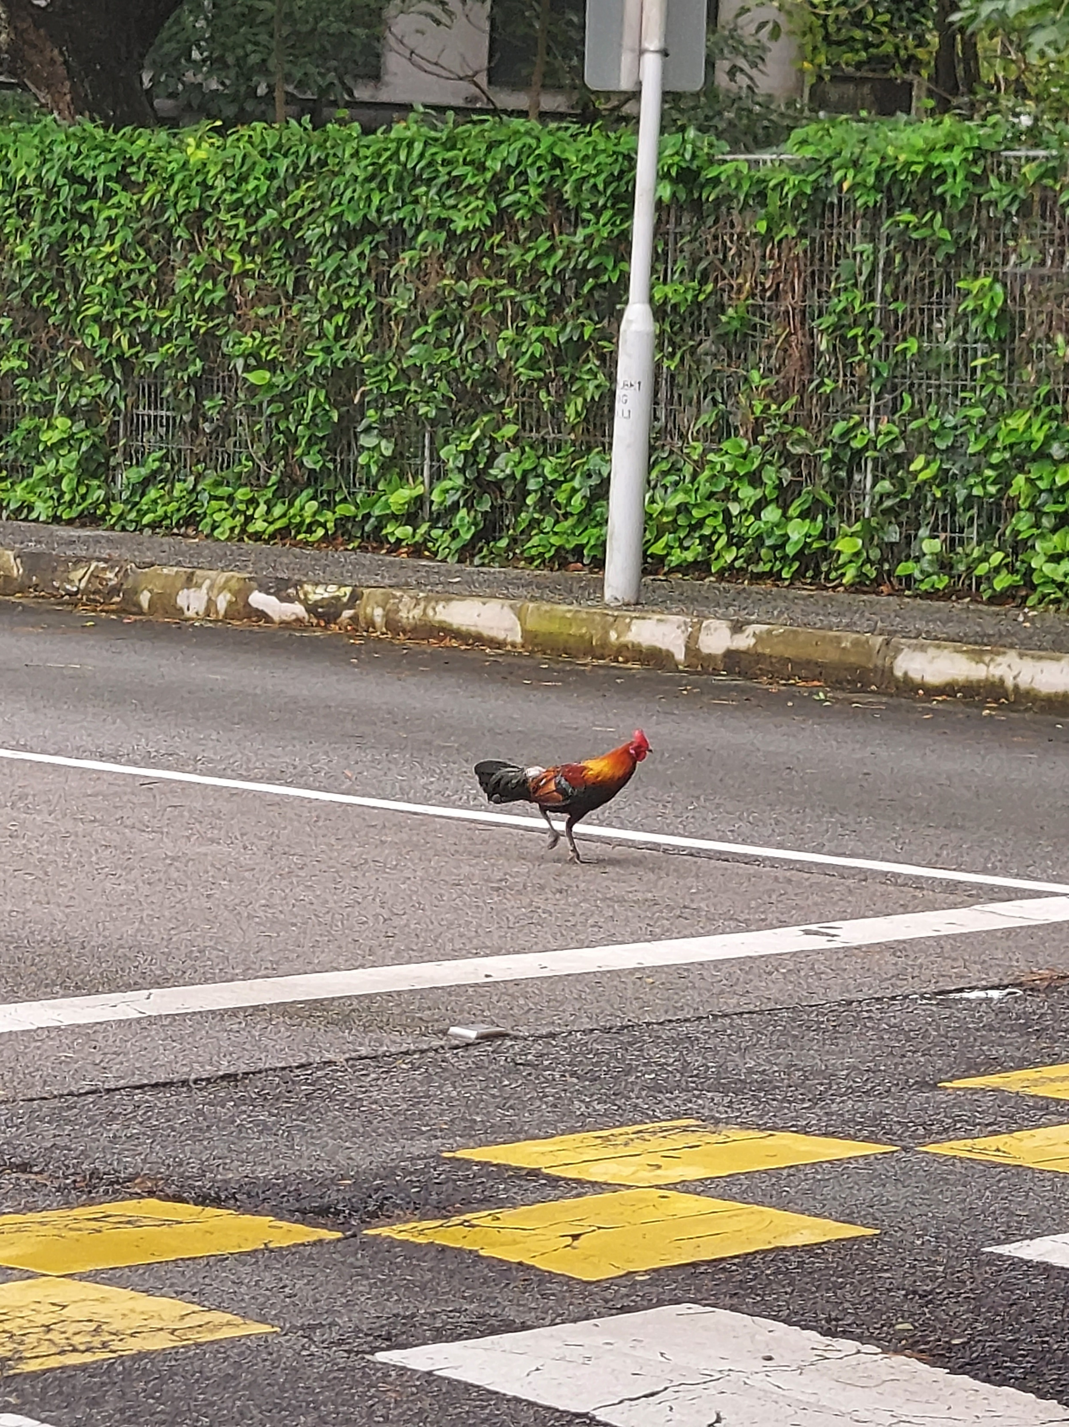
Importance

Slide 4
Statistical Methods
LBP and GLCM

Slide 5
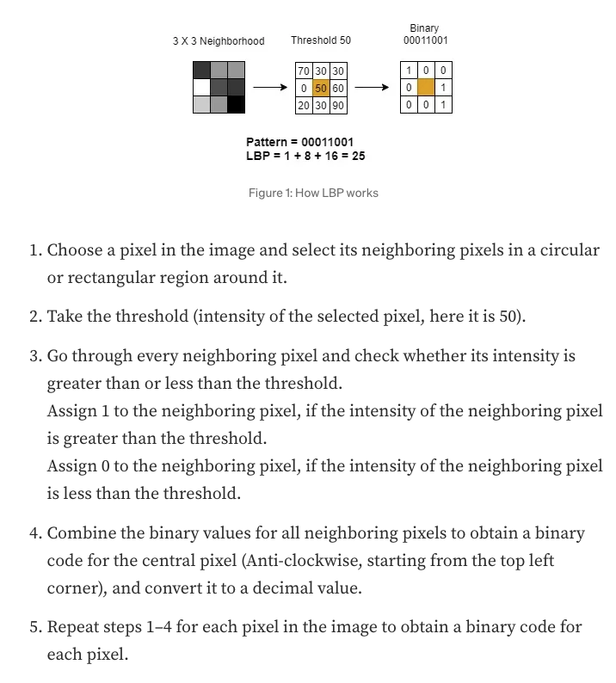
Local Binary Pattern (LBP)
https://medium.com/@aihalapathirana/understanding-the-local-binary-pattern-lbp-a-powerful-method-for-texture-analysis-in-computer-4fb55b3ed8b8

Slide 6
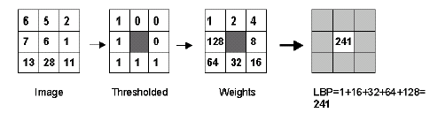
Statistical Methods: LBP
In a 3x3 neighborhood, to have the LBP of the center, we assign different weights to its neighbors, then compute the sum of weights for neighbors bigger than or equal to the center. Then we slide to the next 3x3 neighborhood.
Definition of neighborhood, weights, and the relation between center/ neighbors can be different.

Slide 7
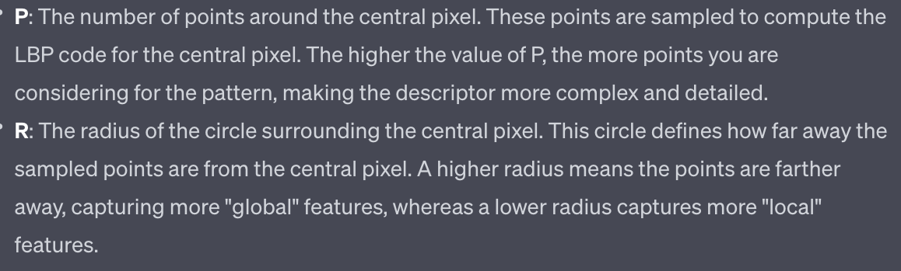
Local Binary Pattern
 | 0 | 1 | 0 |  |  | 1 | 2 | 4 |  |  | 0 | 0 | 2 | 4 | 2 | 0 | 0
 | 8 |  | 2 |  |  | 128 |  | 8 |  |  | 0 | 1 | 0 | 0 | 0 | 1 | 0
 | 0 | 4 | 0 |  |  | 64 | 32 | 16 |  |  | 2 | 0 | 0 | 0 | 0 | 0 | 2
 |  |  |  |  |  |  |  |  |  |  | 4 | 0 | 0 | 0 | 0 | 0 | 4
 |  |  |  |  |  |  |  |  |  |  | 2 | 0 | 0 | 0 | 0 | 0 | 2
 |  |  |  |  |  |  |  |  |  |  | 0 | 1 | 0 | 0 | 0 | 1 | 0
 |  |  |  |  |  |  |  |  |  |  | 0 | 0 | 2 | 4 | 2 | 0 | 0
 |  |  |  |  |  |  |  |  |  |  | 0 | 0 | 1 | 2 | 4 | 0 | 0
 |  |  |  |  |  |  |  |  |  |  | 0 | 32768 | 0 | 0 | 0 | 8 | 0
 |  |  |  |  |  |  |  |  |  |  | 16384 | 0 | 0 | 0 | 0 | 0 | 16
 |  |  |  |  |  |  |  |  |  |  | 8192 | 0 | 0 | 0 | 0 | 0 | 32
 |  |  |  |  |  |  |  |  |  |  | 4096 | 0 | 0 | 0 | 0 | 0 | 64
 |  |  |  |  |  |  |  |  |  |  | 0 | 2048 | 0 | 0 | 0 | 128 | 0
 |  |  |  |  |  |  |  |  |  |  | 0 | 0 | 1024 | 512 | 256 | 0 | 0

Slide 8
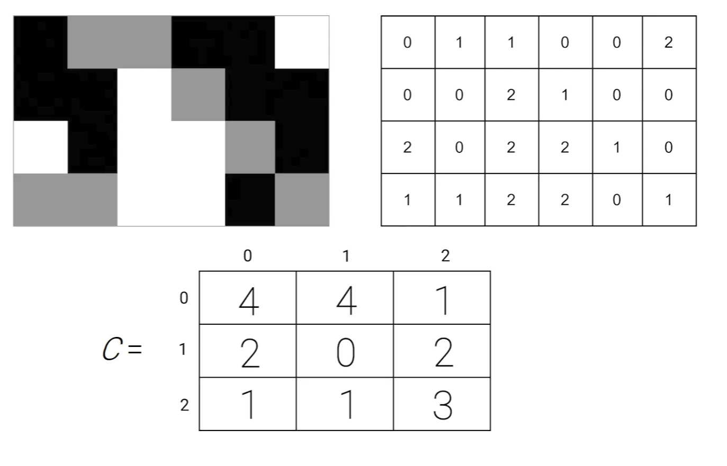
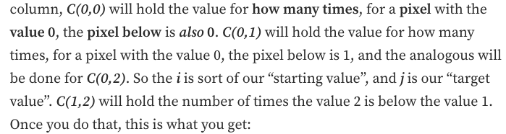
Grey-level Co-occurrence Matrices
Find a pattern along certain direction

Slide 9
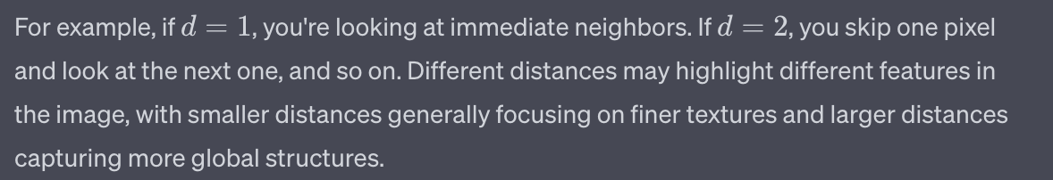

Statistical Methods: GLCM Grey-level Co-occurrence Matrices
Usually,
$Θ=\{0^{o}$, ${90}^{o}\}$ , or,
$Θ=\{0^{o}$, ${45}^{o}$, ${90}^{o}$, ${135}^{o}\}$
And
d= {1,3,9} , or,
d= {1,4,16} , or ….

Slide 10
Statistical Methods: GLCM Grey-level Co-occurrence Matrices
Functions to be applied on GLCM matrices:

Slide 11
Statistical Methods: GLCM Grey-level Co-occurrence Matrices
Each proposed function represents certain properties of the texture. Maximum and Energy, ( f1 and f2), are basic statistics of Φ.
Entropy, f3 , measures the texture homogeneity.
Correlation function, f4, is image linearity metric.
Linear directional structures in direction θ result in large
correlation values in that direction. This can also measure the image coarseness.
Inverse Difference Moment (IDM), f5, measures the extent to which the same tones tend to be neighbours.
Inertia (or Contrast), f6, is a texture dissimilarity measure.

